Slide 1
https://github.com/APPAU/iControl
wiki

Slide 2
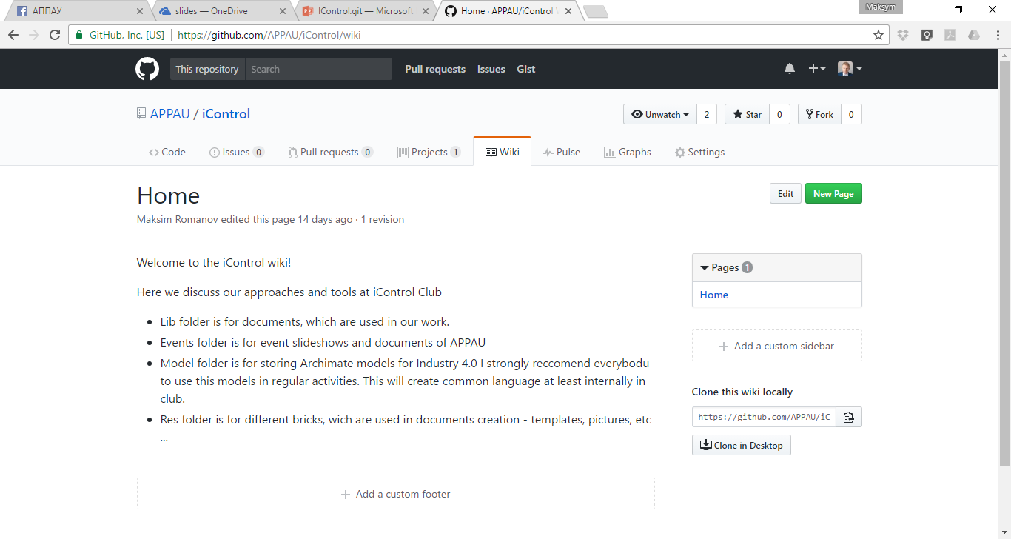
https://github.com/APPAU/iControl/wiki

Slide 3
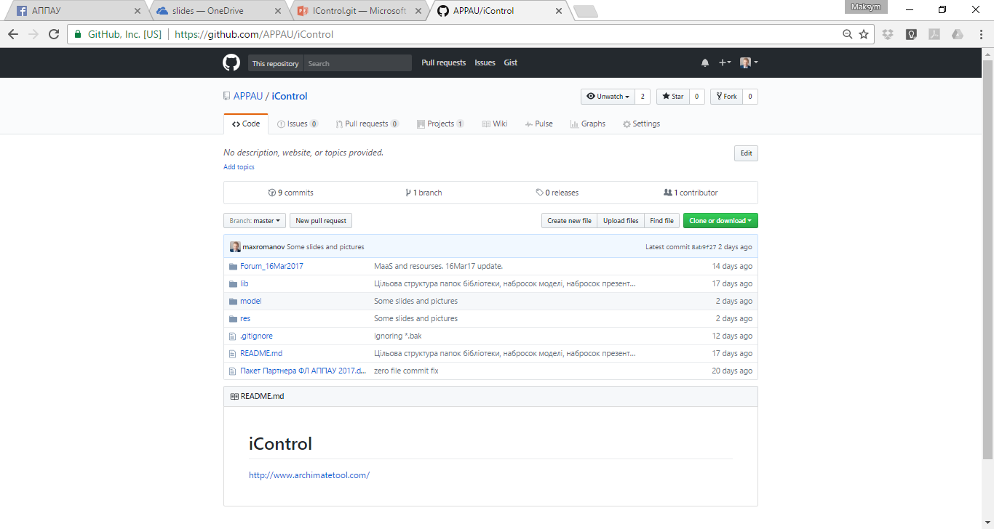
https://github.com/APPAU/iControl

Slide 4
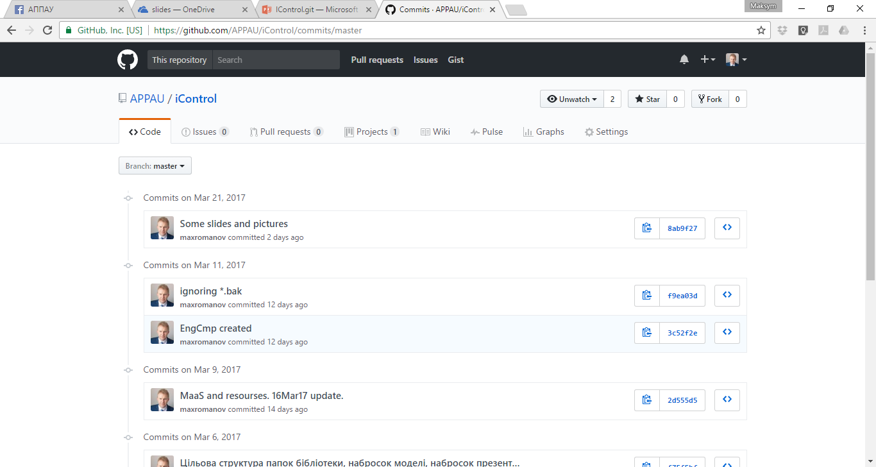
https://github.com/APPAU/iControl/commits/master

Slide 5
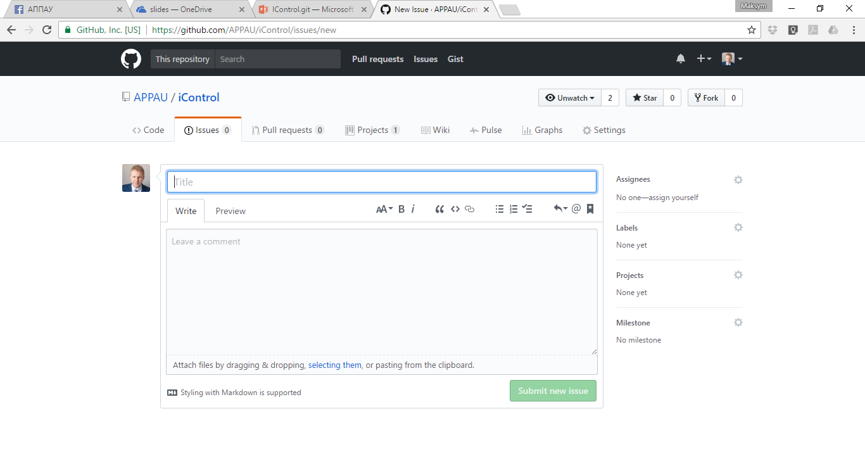
https://github.com/APPAU/iControl/issues

Slide 6
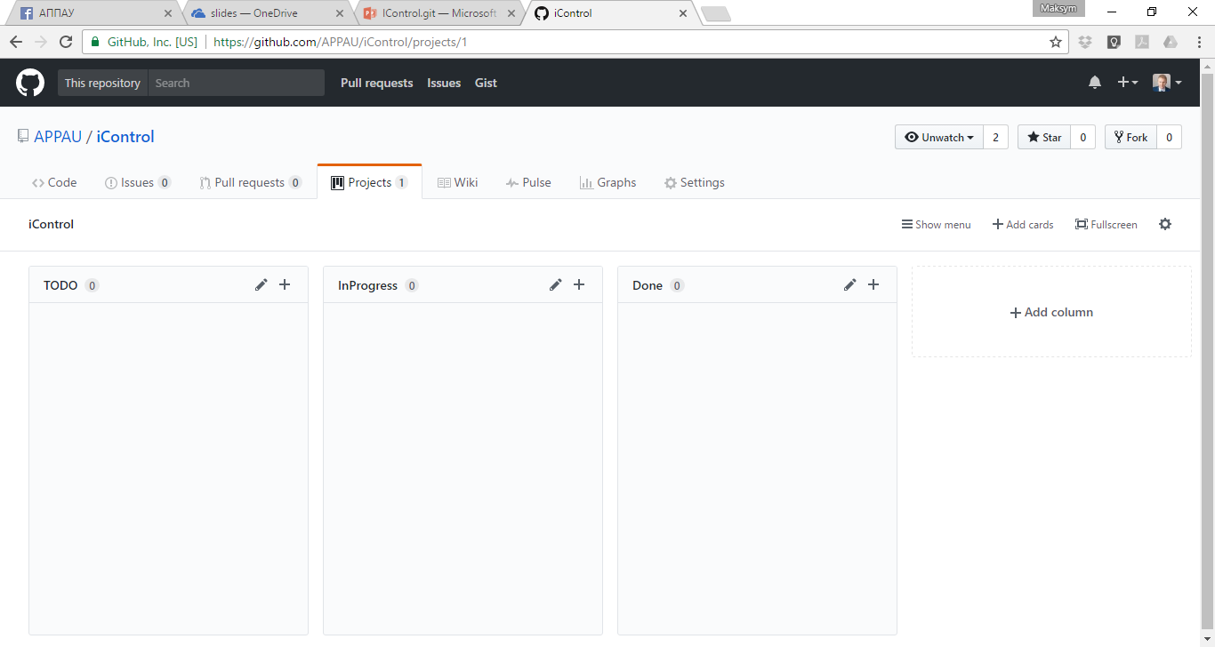
https://github.com/APPAU/iControl/projects/1

Slide 7
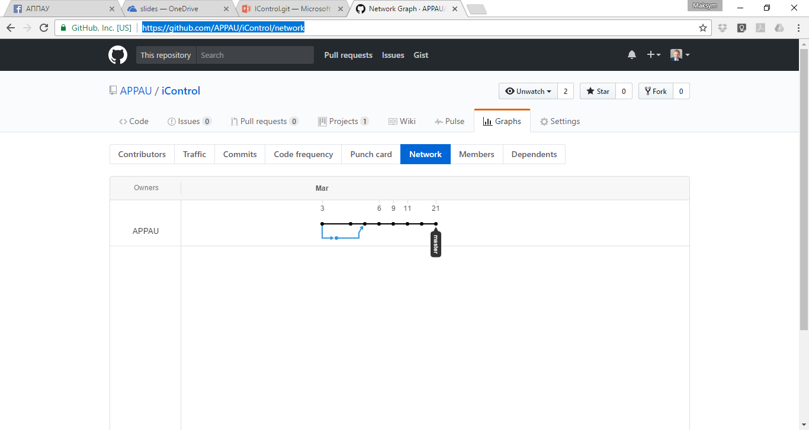
https://github.com/APPAU/iControl/network

Slide 8
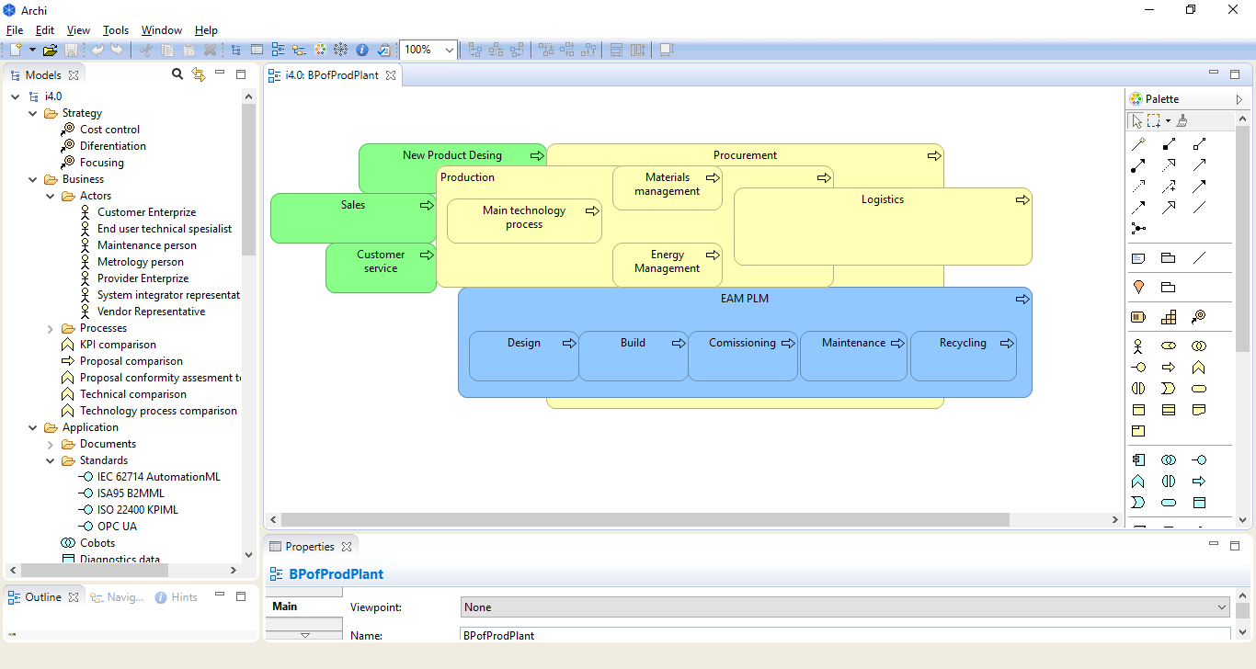
http://www.archimatetool.com/

Slide 9
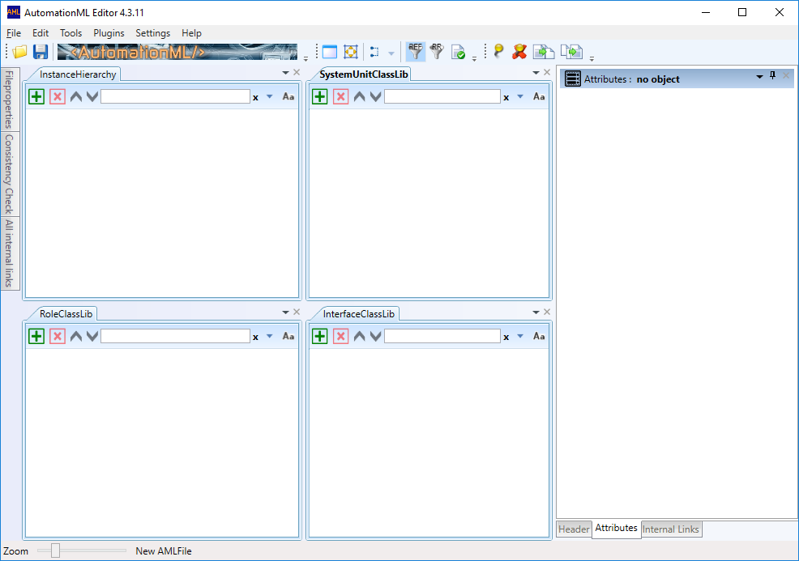
https://www.automationml.org/o.red.c/dateien.html?cat=1

Slide 10
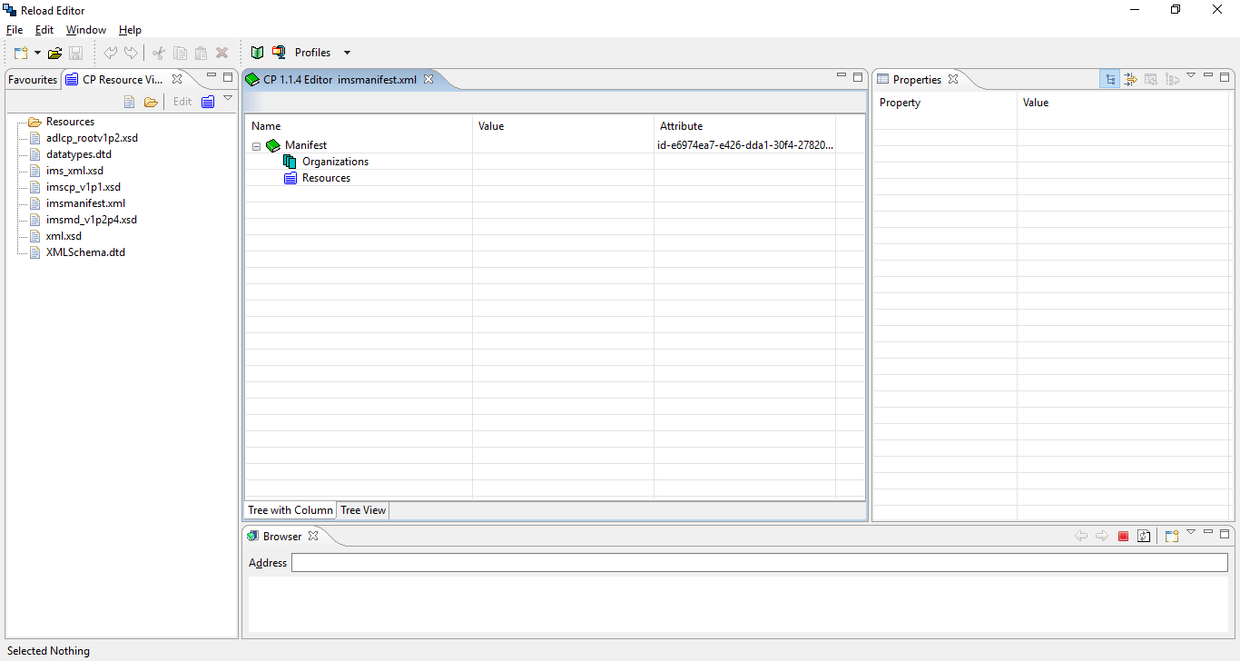

Editor : http://www.reload.ac.uk/editor.html
Player : http://www.reload.ac.uk/scormplayer.html

